Slide 1
302- Software Engineering

Slide 2
UNIT 1 : Introduction
1.1 Concept of software?
1.2 Software characteristics.
1.3 Software Engineering: definition.
1.4 Types of Software

Slide 3
Definition
Software is
(1) Instructions (computer programs) that when executed provide desired function and performance,
(2) Data structures that enable the programs to adequately ( sufficiently ) manipulate information,
and
(3) Documents that describe the operation and use of the programs.

Slide 4
Software Characteristics
Software is developed or engineered, it is not manufactured in the classical sense
Software doesn't "wear out“
Although the industry is moving toward component-based assembly, most software continues to be custom built

Slide 5
Software is developed or engineered, it is not manufactured in the classical sense.

Slide 6
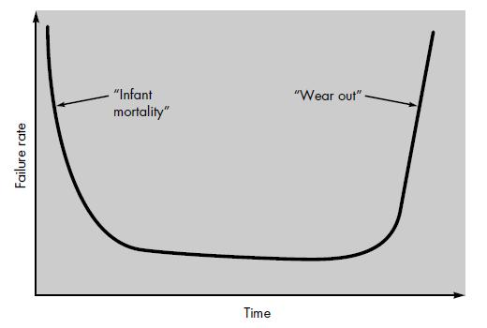
2. Software doesn't "wear out"
Bathtub curve
Failure curve for hardware

Slide 7
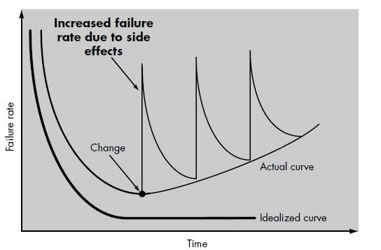
Idealized and actual failure curves for software

Slide 8
3. Although the industry is moving toward component-based assembly, most software continues to be custom built.

Slide 9
Software Engineering
Software engineering is the establishment and use of sound engineering principles in order to obtain economically software that is reliable and works efficiently on real machines.
OR
“More than a discipline or a body of knowledge, engineering is a verb, an action word, a way of approaching a problem”
- Scott Whitmire

Slide 10
Software Engineering:
  (1) The application of a systematic, disciplined, quantifiable approach to the development, operation, and maintenance of software; that is, the application of engineering to software. (2) The study of approaches as in (1).

Slide 11
Types of Software OR S/WApplication
System software
Real-time software
Business software
Engineering and scientific software
Embedded software
Personal computer software
Web-based software
Artificial intelligence software

Slide 12
1. System Software
System software is a collection of programs written to service other programs.
system software area is characterized by heavy interaction with computer hardware.
heavy usage by multiple users; concurrent operation that requires scheduling, resource sharing, and sophisticated process management; complex data structures; and multiple external interfaces.

Slide 13
Examples
Compilers
Editors
File management utilities
Operating system components
Drivers
Telecommunications processors

Slide 14
2. Real-Time Software
Software that monitors/ analyzes/ controls real-world events as they occur is called real time.
Elements of real-time software include a data gathering component that collects and formats information from an external environment.
Examples:
  Flood Control Software

Slide 15
3. Business Software
Business information processing is the largest single software application area.
In addition to conventional data processing application, business software applications also encompass interactive computing
Example :
  payroll
  accounts receivable/payable,
  Inventory

Slide 16
4. Engineering and scientific software.
Engineering and scientific software have been characterized by "number crunching" algorithms.
Applications range from astronomy to volcanology, from automotive stress analysis to space shuttle orbital dynamics, and from molecular biology to automated manufacturing.

Slide 17
Examples:
SPSS (Statistical Package for Social Services)
Software of space shuttle
Construction Software

Slide 18
5. Embedded Software
Embedded software resides in read-only memory and is used to control products and systems for the consumer and industrial markets.
Embedded software can perform very limited and esoteric functions.

Slide 19
Example:
Keypad control for a microwave oven
digital functions in an automobile such as fuel control

Slide 20
6. Personal computer software
The Software used in Personal Computer are known as Personal Computer Software
Examples:
Word processing
Spreadsheets
computer graphics
Multimedia
Entertainment
Database Management
Personal and Business Financial Applications
External Network

Slide 21
7. Web-based software
The Web pages retrieved by a browser are software that incorporates executable instructions.
Example:
  CGI
  HTML
  Perl
  Java

Slide 22
8. Artificial intelligence software
  Artificial intelligence (AI) software makes use of non-numerical algorithms to solve complex problems that are not amenable to computation or straightforward analysis.
  Example
    pattern recognition (image and voice)
    game playing

